Slide 1
Chapter 2
Overview of the
Financial System

Slide 2
Financial System Overview (2)
Financial Markets
Financial Institutions
Bond Market (3,5,12)
Stock Market (13,6)
Money Market (11)
Mortgage Market (14)
Why Exists (7)
Banking Industry (19)
Mutual Fund Industry(20)
Hedging with Financial Derivatives (24)

Slide 3
Chapter Preview
In this chapter, we examine the role of the financial system in an advanced economy.
We study the effects of financial markets and institutions on the economy, and look at their general structure and operations.

Slide 4
Chapter Outline
Function of Financial Markets
Structure of Financial Markets
Internationalization of Financial Markets
Function of Financial Intermediaries: Indirect Finance
Types of Financial Intermediaries
Regulation of the Financial System

Slide 5
Function of Financial Markets
Channels funds from person or business without investment opportunities (i.e., “Lender-Savers”) to one who has them (i.e., “Borrower-Spenders”)
Improves economic efficiency
Lender-Savers
Households
Business firms
Government
Foreigners
Borrower-Spenders
Business firms
Government
Households
Foreigners

Slide 6
Segments of Financial Markets
Direct Finance
Borrowers borrow directly from lenders in financial markets by selling financial instruments which are claims on the borrower’s future income or assets
Indirect Finance
Borrowers borrow indirectly from lenders via financial intermediaries (established to source both loanable funds and loan opportunities) by issuing financial instruments which are claims on the borrower’s future income or assets

Slide 7
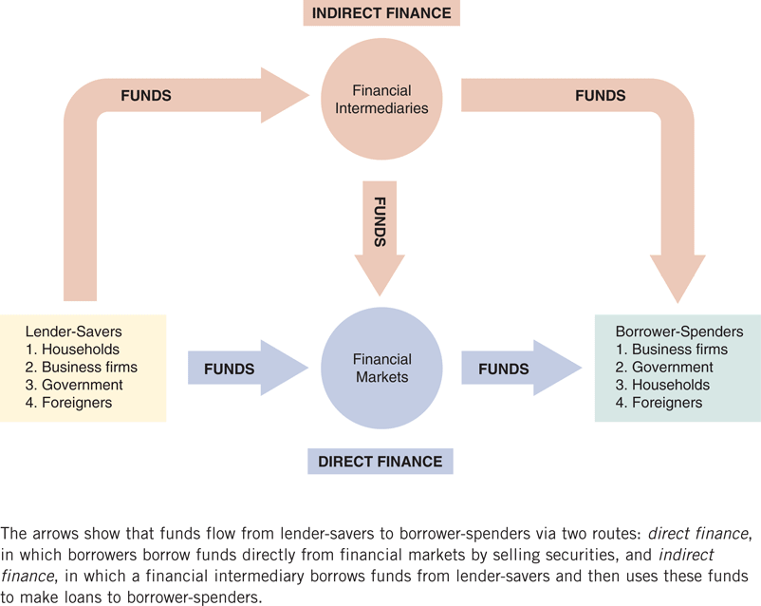
Figure 2.1 Flows of Funds Through the Financial System

Slide 8
Importance of Financial Markets
This is important. For example, if you save $1,000, but there are no financial markets, then you can earn no return on this - might as well put the money under your mattress.
However, if a carpenter could use that money to buy a new saw (increasing her productivity), then she is willing to pay you some interest for the use of the funds.

Slide 9
Importance of Financial Markets
Financial markets are critical for producing an efficient allocation of capital, allowing funds to move from people who lack productive investment opportunities to people who have them.
Financial markets also improve the well-being of consumers, allowing them to time their purchases better.

Slide 10
Structure of the markets
Debt vs Equity
Primary vs Secondary
Exchanges vs OTC
Money vs Capital

Slide 11
Structure of Financial Markets
Debt Markets
Short-Term (maturity < 1 year)
Long-Term (maturity > 10 year)
Intermediate term (maturity in-between)
Equity Markets
Pay dividends, in theory forever
Represents an ownership claim in the firm

Slide 12
Structure of Financial Markets
Primary Market
Markets in which users of funds (e.g. corporations, governments) raise funds by issuing financial instruments (e.g. stocks and bonds)
New security issues sold to initial buyers
Typically involves an investment bank who underwrites the offering
For example, Intel would like to issue 100 million new shares, will Intel sell the shares by themselves or by some investment banks?
Most of the time, investment banks will underwrite it. However, there are lots of studies about this IPO, and find the firm need to pay about 7-8% fee.

Slide 13
Structure of Financial Markets
Secondary Market
Securities previously issued are bought and sold
Examples include the NYSE and Nasdaq
Involves both brokers and dealers (do you know the difference?)
Even though firms don’t get any money, per se, from the secondary market, it serves two important functions:
Provides liquidity, making it easy to buy and sell the securities of the companies
Establishes a price for the securities (useful for company valuation)

Slide 14
Structure of Financial Markets
We can further classify secondary markets as follows:
Exchanges
Trades conducted in central locations (e.g., New York Stock Exchange, American Stock Exchanges, Chicago Board, and etc.) (http://www.nyse.com)
Over-the-Counter Markets
Dealers at different locations who have an inventory of securities stand ready to buy and sell securities “over the counter” to anyone who comes to them and is willing to accept their price. , (http://www.nasdaq.com)
Best example is the market for Treasury Securities

Slide 15
Classifications of Financial Markets
We can also classify markets by the maturity of the securities:
Money Market: Short-Term (maturity < 1 year)
Capital Market: Long-Term (maturity > 1 year) plus equities (no maturity)

Slide 16
Internationalization of Financial Markets
The internationalization of markets is an important trend. The U.S. no longer dominates the world stage.
International Bond Market & Eurobonds
Foreign bonds
Denominated in a foreign currency
Targeted at a foreign market
Eurobonds
Denominated in one currency, but sold in a different market. (e.g., GE sells bond in India for Japanese Yen)
Now larger than U.S. corporate bond market
Over 80% of new bonds are Eurobonds

Slide 17
Internationalization of Financial Markets
Eurocurrency Market
Foreign currency deposited outside of home country
Eurodollars are U.S. dollars deposited, say, London.
World Stock Markets
U.S. stock markets are no longer always the largest—at one point, Japan’s was larger (in the mid-1980)

Slide 18
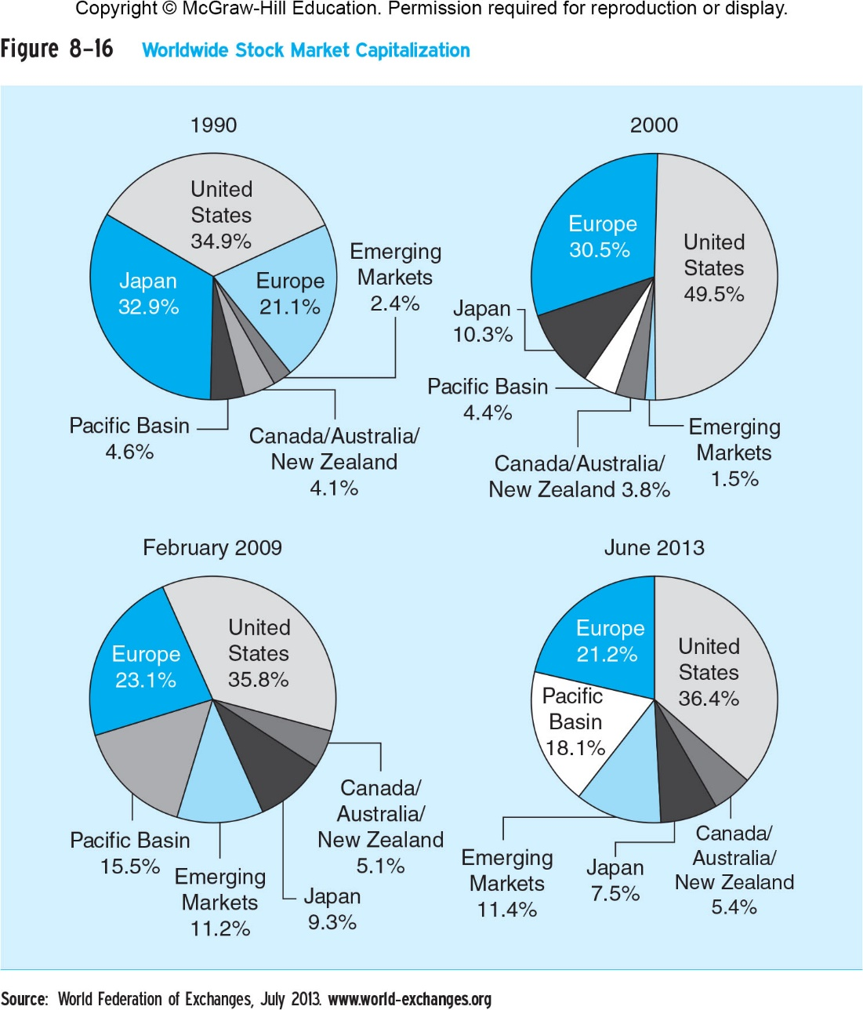

Slide 19
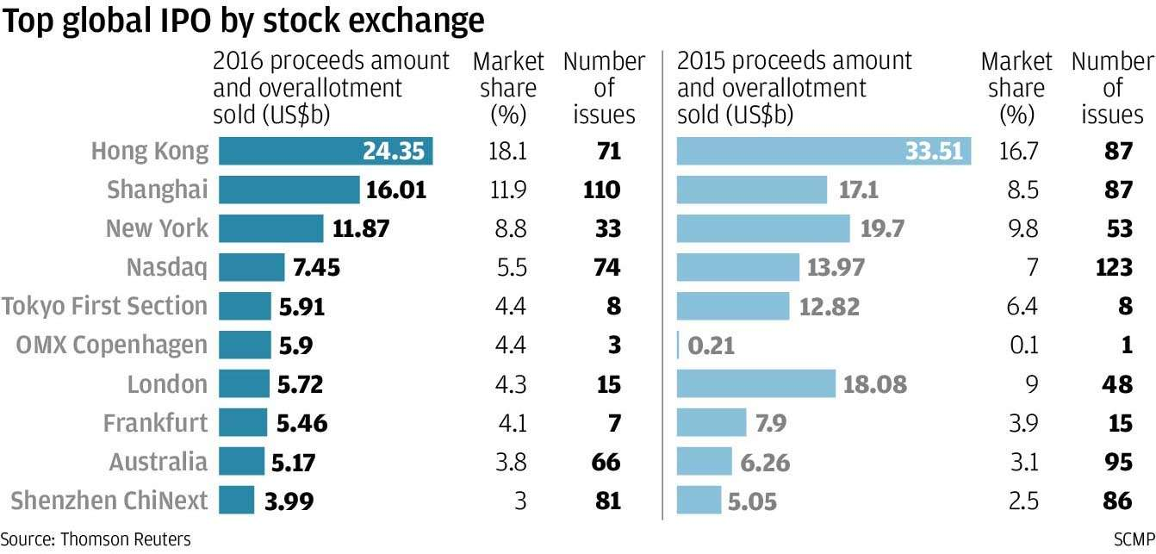
http://www.scmp.com/business/companies/article/2057428/hong-kong-tops-global-ipo-markets-despite-total-funds-raised

Slide 20
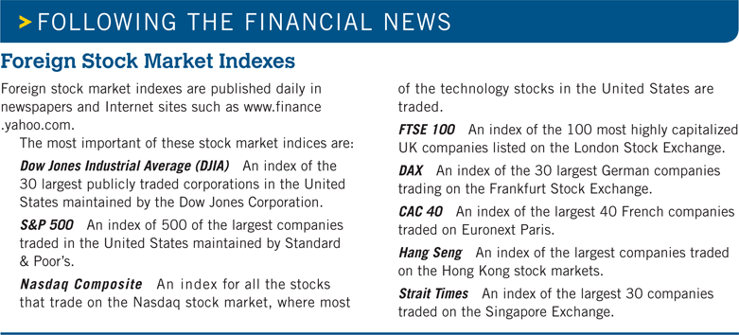
Internationalization of Financial Markets

Slide 21
Chapter Outline
Function of Financial Markets
Structure of Financial Markets
Internationalization of Financial Markets
Function of Financial Intermediaries: Indirect Finance
Types of Financial Intermediaries
Regulation of the Financial System

Slide 22
Function of Financial Intermediaries: Indirect Finance
We now turn our attention to the top part of Figure 2.1—indirect finance.

Slide 23
Function of Financial Intermediaries: Indirect Finance
Instead of savers lending/investing directly with borrowers, a financial intermediary (such as a bank) plays as the middleman:
the intermediary obtains funds from savers
the intermediary then makes loans/investments with borrowers
More important source of finance than securities markets (such as stocks)

Slide 24
Why Financial Intermediaries Needed
Asymmetric information
Risk sharing
Transactions costs

Slide 25
Function of Financial Intermediaries: Indirect Finance
Transactions Costs
Time and money spend in carrying out financial transactions.
hire a lawyer ➔ loan contract: interest rate, when repay the loan
Financial Intermediaries can reduce transactions costs by developing expertise and taking advantage of economies of scale
Financial intermediaries make profits by reducing transactions costs

Slide 26
Function of Financial Intermediaries: Indirect Finance
Risk Sharing
Asset Transformation (banks, life insurance companies)
FIs create and sell assets with lesser risk to one party and then use the funds to buy assets with greater risk from another party.
In a sense risky assets are turned into safer assets for investors
Earn on risky assets
Pay on the assets that they have sold
Profit: spread between earn and pay.
Diversification (mutual funds, finance companies)
Lower risk by helping people to diversify portfolios
Portfolio: a collection of assets whose returns do not always move together (you shouldn’t put all your eggs in one basket).
Overall risk is lower than for individual assets.
Financial intermediaries pool a collection of assets into a new asset and then sell it to individuals.

Slide 27
Function of Financial Intermediaries: Indirect Finance
Asymmetric Information.
One party doesn’t have enough information about other party
Adverse Selection
Before transaction occurs
Potential borrowers most likely to produce adverse outcomes are ones most likely to seek loans and be selected (bad credits seek loans most actively).
Brother A: conservative, only when he is sure that he can pay back the money, he borrows;
Brother B: gambler, willing to try his luck even when there’s only 1% possibility of to be millionaire;
Which one of them will call you more frequently and is more eager to have the money?
Similar problems occur with insurance where unhealthy people want their known medical problems covered

Slide 28
Function of Financial Intermediaries: Indirect Finance
Asymmetric Information.
One party doesn’t have enough information about other party
Moral Hazard
After transaction occurs
Hazard that borrower has incentives to engage in undesirable (immoral) activities making it more likely that won’t pay loan back (conflicts of interest)
Again, with insurance, people may engage in risky activities only after being insured
For example: World.com, Nortel scandal, Enron
Financial intermediaries reduce adverse selection and moral hazard problems, enabling them to make profits. How they accomplish this is covered in many of the chapters to come.

Slide 29
Types of Financial Intermediaries
Depository Institutions (banks)
Contractual savings institutions
Investment intermediaries

Slide 30
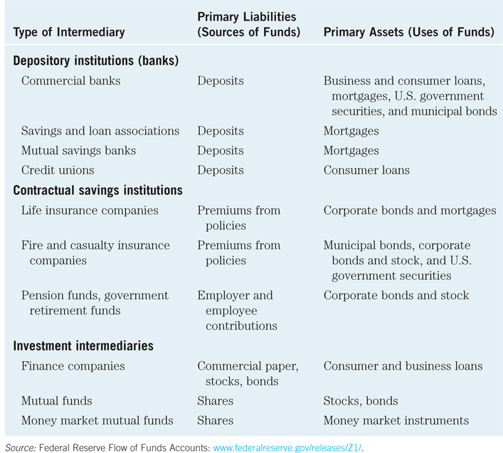

Slide 31
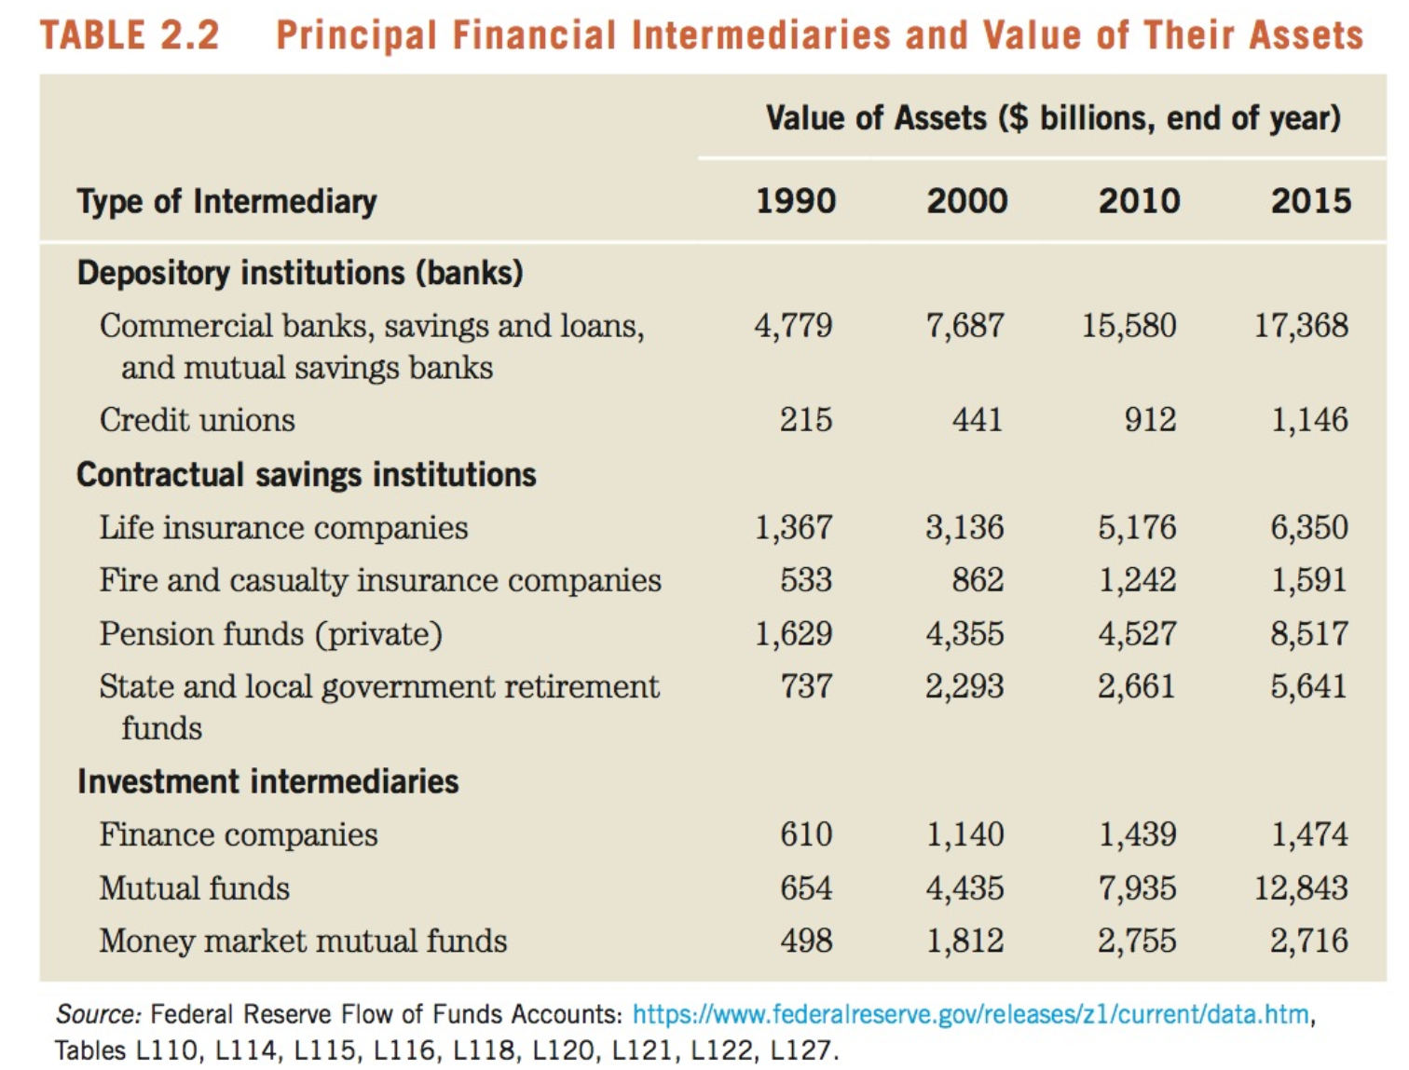

Slide 32
Types of Financial Intermediaries: Depository Institutions
Depository Institutions (Banks): accept deposits and make loans. These include commercial banks and thrifts.
Commercial banks (11,343 at end of 2012)
Raise funds primarily by issuing checkable, savings, and time deposits which are used to make commercial, consumer and mortgage loans
Collectively, these banks comprise the largest financial intermediary and have the most diversified asset portfolios
Thrifts: S&Ls & Mutual Savings Banks (918) and Credit Unions (905)
Raise funds primarily by issuing savings, time, and checkable deposits which are most often used to make mortgage and consumer loans, with commercial loans also becoming more prevalent at S&Ls and Mutual Savings Banks
Mutual savings banks and credit unions issue deposits as shares and are owned collectively by their depositors, most of which at credit unions belong to a particular group, e.g., a company’s workers

Slide 33
Types of Financial Intermediaries: Contractual Savings Institutions (CSIs)
All CSIs acquire funds from clients at periodic intervals on a contractual basis and have fairly predictable future payout requirements.
Life Insurance Companies receive funds from policy premiums, can invest in less liquid corporate securities and mortgages, since actual benefit pay outs are close to those predicted by actuarial analysis
Fire and Casualty Insurance Companies receive funds from policy premiums, must invest most in liquid government and corporate securities, since loss events are harder to predict
Pension and Government Retirement Funds hosted by corporations and state and local governments acquire funds through employee and employer payroll contributions, invest in corporate securities, and provide retirement income via annuities

Slide 34
Types of Financial Intermediaries: Investment Intermediaries
Investment Intermediaries:
Finance Companies sell commercial paper (a short-term debt instrument) and issue bonds and stocks to raise funds to lend to consumers to buy durable goods, and to small businesses for operations.
Mutual Funds acquire funds by selling shares to individual investors (many of whose shares are held in retirement accounts) and use the proceeds to purchase large, diversified portfolios of stocks and bonds.
Money Market Mutual Funds acquire funds by selling checkable deposit-like shares to individual investors and use the proceeds to purchase highly liquid and safe short-term money market instruments.
Investment Banks advise companies on securities to issue, underwriting security offerings, offer M&A assistance, and act as dealers in security markets.

Slide 35
Chapter Outline
Function of Financial Markets
Structure of Financial Markets
Internationalization of Financial Markets
Function of Financial Intermediaries: Indirect Finance
Types of Financial Intermediaries
Regulation of the Financial System

Slide 36
Regulation of Financial Markets
Main Reasons for Regulation
Increase Information to Investors
Ensure the Soundness of Financial Intermediaries

Slide 37
Regulation Reason: Increase Investor Information
Asymmetric information in financial markets means that investors may be subject to adverse selection and moral hazard problems that
may hinder the efficient operation of financial markets and
may also keep investors away from financial markets.

Slide 38
Regulation Reason: Increase Investor Information
The Securities and Exchange Commission (SEC) requires corporations issuing securities to disclose certain information about their sales, assets, and earnings to the public and restricts trading by the largest stockholders (known as insiders) in the corporation.
Such government regulation can reduce adverse selection and moral hazard problems in financial markets and increase their efficiency by increasing the amount of information available to investors. Indeed, the SEC has been particularly active recently in pursuing illegal insider trading.

Slide 39
Regulation Reason: Ensure Soundness of Financial Intermediaries
Providers of funds (depositors, like you) to financial intermediaries may not be able to assess whether the institutions holding their funds are sound or not.
If they have doubts about the overall health of financial intermediaries, they may want to pull their funds out of both sound and unsound institutions, which can lead to a financial panic.
Such panics produces large losses for the public and causes serious damage to the economy.

Slide 40
Regulations
Restrictions on Entry
Disclosure
Restrictions on Assets and Activities
Deposit Insurance
Limits on Competition
Restrictions on Interest Rates

Slide 41
Regulation: Restriction on Entry
Restrictions on Entry
Regulators have created tight regulations as to who is allowed to set up a financial intermediary
Individuals or groups that want to establish a financial intermediary, such as a bank or an insurance company, must obtain a charter from the state or the federal government
Only if they are upstanding citizens with impeccable credentials and a large amount of initial funds will they be given a charter

Slide 42
Regulation: Disclosure
There are stringent reporting requirements for financial intermediaries
Their bookkeeping must follow certain strict principles
Their books are subject to periodic inspection
They must make certain information available to the public

Slide 43
Regulation: Restriction on Assets and Activities
There are restrictions on what financial intermediaries are allowed to do and what assets they can hold
One way of doing this is to restrict the financial intermediary from engaging in certain risky activities
Another way is to restrict financial intermediaries from holding certain risky assets, or at least from holding a greater quantity of these risky assets than is prudent
Before you put your funds into a bank or some other similar institution, you want to know that your funds are safe and that the financial intermediary will be able to meet its obligations to you

Slide 44
Regulation: Deposit Insurance
The government can insure people’s deposits to a financial intermediary from any financial loss if the financial intermediary should fail
The Federal Deposit Insurance Corporation (FDIC) insures each depositor at a commercial bank or mutual savings bank up to a loss of $250,000 per account
Hong Kong Deposit Protection Board: HK$500,000

Slide 45
Regulation: Limits on Competition
Evidence is weak showing that competition among financial intermediaries promotes failures that will harm the public. However, such evidence has not stopped the state and federal governments from imposing many restrictive regulations.
In the past, banks were not allowed to open branches in other states, and in some states banks were restricted from opening additional locations.

Slide 46
Regulation: Restrictions on Interest Rates
Competition has also been inhibited by regulations that impose restrictions on interest rates that can be paid on deposits
These regulations were instituted because of the widespread belief that unrestricted interest-rate competition helped encourage bank failures during the Great Depression
Later evidence did not support this view, and restrictions on interest rates have been abolished

Slide 47
Regulation Reason: Improve Monetary Control
Because banks play a very important role in determining the supply of money (which in turn affects many aspects of the economy), regulation of these financial intermediaries is intended to improve control over the money supply
One example is reserve requirements, which make it obligatory for all depository institutions to keep a certain fraction of their deposits in accounts with the Federal Reserve System (the Fed), the central bank in the United States
Reserve requirements help the Fed exercise more precise control over the money supply

Slide 48
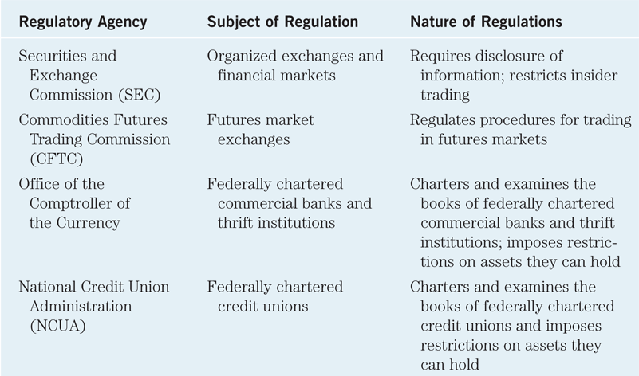

Slide 49
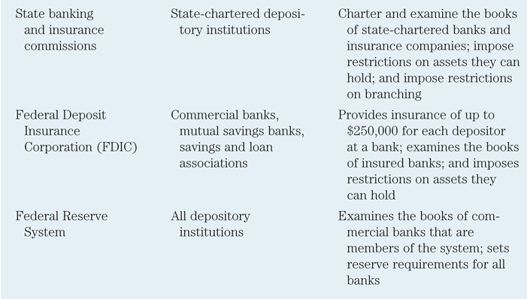

Slide 50
Summary
Overview of Financial Markets
Function of Financial Markets
Classifications of Financial Markets
Internationalization of Financial Market
Overview of Financial Intermediaries
Function of Financial Intermediaries
Regulatory of Financial Markets

